Slide 1
Fabric Network
Runtime Architecture
2020.12

Slide 2
Content
Architecture Overview
Roles
Relationship
Conclusion

Slide 3
Learning Advices
内容冗杂
难度颇高
思路清晰（图）
懂得取舍
优先实践

Slide 4
Part 1: Architecture Overview

Slide 5
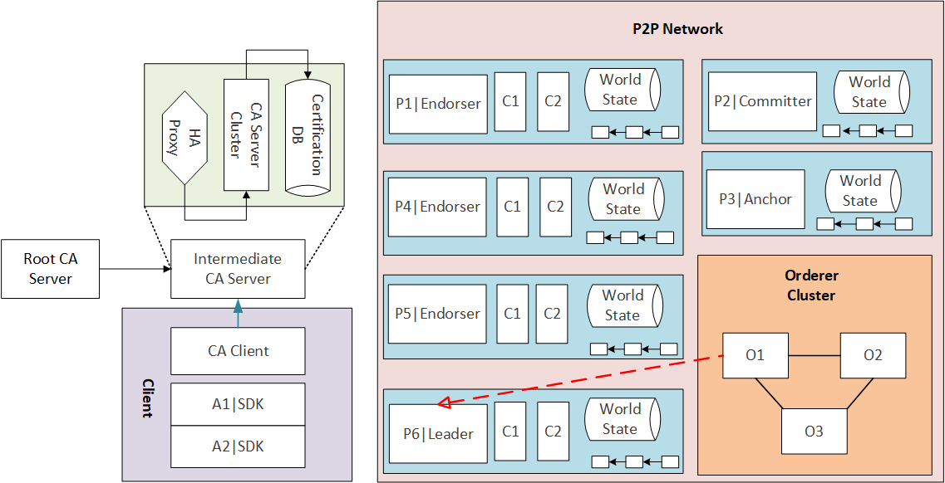
Architecture Overview

Slide 6
Part 2: Roles

Slide 7
Roles
Peer
Orderer
CA
Client

Slide 8
1. Peer
Committer
Endorser
Anchor
Leader

Slide 9
1. Peer
Endorser Proxy:
P = {AND(P1, P2), OR(P1, P2), OutOf(m, P1, P2, ..., Pn), m <= n}
【策略实例】

Slide 10
1. Peer
Chain Code

Slide 11
1. Peer
Ledger
Blockchain
World State DB

Slide 12
1. Peer
Ledger
Private Data
Private Block
Private DB

Slide 13
1. Peer
Gossip Protocol

Slide 14
2. Orderer
【】

Slide 15
2. Orderer
Order Proxy

Slide 16
3. CA
CA Server
Root CA
Intermediate CA

Slide 17
3. CA
CA Client

Slide 18
3. CA
MSP

Slide 19
4. Client
Application

Slide 20
4. Client
SDK

Slide 21
Part 3: Relationship

Slide 22
Relationship
Channel
Organization
Cluster

Slide 23
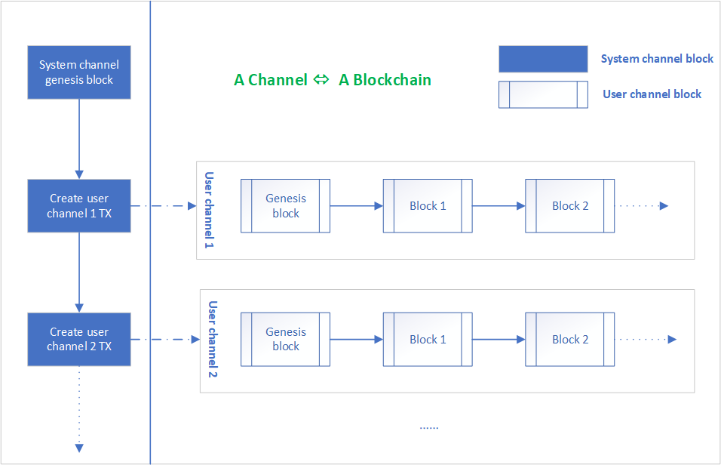
1. Channel

Slide 24
2. Organization

Slide 25
3. Cluster

Slide 26
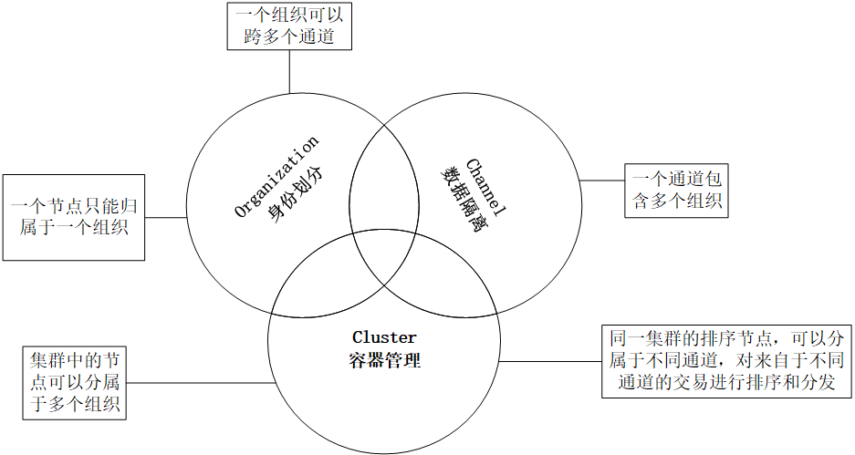

Slide 27
Part 4: Conclusion

Slide 29
Thank you

